Slide 1
Data Binding
Karl Shifflett
Program Manager
Microsoft Corporation

Slide 2
Overview

Slide 3
Overview
Introduction to Data Binding
Fundamentals
Visualizing Data
Collections
Conversions
Validation

Slide 4
Introduction to Data Binding

Slide 5
Introduction to Data Binding
Data Binding in WPF
Data Binding In XAML
Data Binding In Code

Slide 6
Data Binding In WPF
Enables UI controls to be associated with live data
When data values change bound properties are updated
When bound property values change the data is updated
Not Just for “Data Controls” Anymore
Any dependency property on any dependency object can be bound to any public property on any CLR object
Controls can also be bound to traditional data sources
XML data sources
ADO.NET datasets
Notes:
In simple terms, Binding is used to keep two data points in sync with each other. A “data point” can best be described as a data source and a query, for example, a property data point would be an object and a property name. the property name determines the property on the source object from which the data should be retrieved
In WPF, The Binding object (System.Windows.Data.Binding) represents a data point. This is created and passed as a parameter to a second data point. The methods of creating this relationship are different in XAML, procedural code and XML

Slide 7
Data Binding In WPF
Binding Target
Binding Source
Dependency Object
Object
Dependency Property
Binding Object
Property
Notes:
[Click]
The Binding Target for a Data Binding operation must be a Dependency Property on a Dependency Object. Examples include the Text property on a button or the isEnabled property on a checkbox.
[Click]
The Binding Source for a Data Binding operation can be any property on a CLR object.
[Click]
The Binding object is used to create the binding between the target and the source. This object is also responsible for keeping both of the objects up to date.

Slide 8
Data Binding in XAML
Binding to Business Objects
Set the DataContext property on a control within the object hierarchy
Use the Binding markup extension
<l:People x:Key="People" /> <!-- Business Object List -->
<Grid DataContext="{StaticResource People}">
<ListBox Name="ListOfPeople" ItemsSource="{Binding}">
Binding to Controls
Set the DataContext, or to the property directly by using the ElementName property
Use the Binding markup extension
<StackPanel
DataContext="{Binding ElementName=ListOfPeople,
Path=SelectedItem}" ...>
<TextBlock Text="{Binding Name}" />
Notes:
Because the SetBinding method cannot be referenced directly from XAML WPF contains a markup extension to make declarative use of binding possible. To use binding in XAML, you set the target property to a binding instance and then use the standard markup extension syntax to set its properties. Bindings are more of a UI control method, it is best practice to add these in the XAML markup as opposed to procedural code.

Slide 9
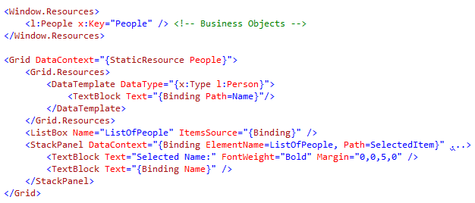
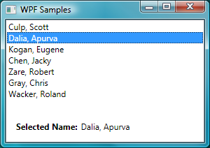

Data Binding in XAML
DataContext
Business Object
Binding by using ElementName to a Control
Binding to Name on the Business Object
Notes:
This Code snippet shows a simple data binding operation directly in XAML. Selecting any name in the list triggers an update to the items in the StackPanel by using the databinding engine.

Slide 10
Binding in Code
Create an instance of the Binding class:
Binding b = new Binding();
Set the Source on the Binding:
b.Source = this.ListOfPeople.SelectedItem;
Set the Path of the Binding:
b.Path = new PropertyPath("Person.Name");
Attach the Binding to a DependencyProperty of the target:
this.NameTextBlock.SetBinding
(TextBlock.TextProperty, b);
Notes:
The Binding object can be created and referenced in your .NET code behind files.
When the Binding object is created, it can be passed the dependency property to be bound as part of its constructor. Each WPF element that inherits from FrameworkElement gains the SetBinding property, which means that all WPF FrameworkElements and Controls are able to be data bound. For objects that do not inherit from Framework can still be target of data binding (providing they are DependencyProperties) by using the BindingOperations class.

Slide 11
Fundamentals

Slide 12
Fundamentals
Components of Data Binding
RelativeSource
Source Paths
Binding to non-Dependency Properties
INotifyPropertyChanged
Binding Modes
UpdateSourceTrigger

Slide 13
Components of Data Binding
A Binding consists of 4 components:
A source
A source path
A target dependency object
A target dependency property
<TextBox IsEnabled="{Binding ElementName=MyCheckBox,Path=IsChecked}"/>
Target Dependency Object
Target Dependency Property
Source
Source Path
Notes:
[Intro]
A Binding consists of 4 components and these will be outlined with the use of a code snippit
[Click]
The Source is the element name that is the “Trigger” for the data change to appear. You will notice in the code snippet above, the source is referred to as MyCheckBox. This is the name given to the checkbox when it was declared (using the x:Name= property in its declaration)
[Click]
The source path is the property on the Source that is being checked. In this example, this is the IsChecked Boolean value is being checked for any changes. Its also worth noting that specifying a source path that doesn’t exist or misspelling a path will not throw up an error but the data binding function will not work until it has been corrected.
[Click]
The Target dependency object is the WPF object that will change or update as a result of the source path changing. In this example, the dependency object is a WPF TextBox.
[Click]
The Target dependency property is the part of the dependency object that will change or update. In the Example, the dependency property is the IsEnabled Boolean value

Slide 14
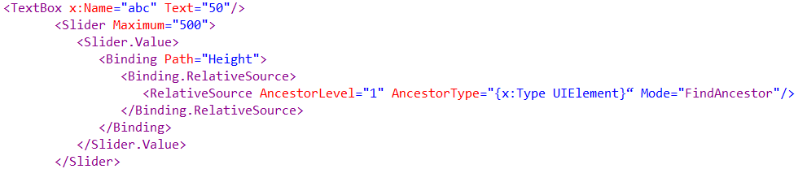
Relative Source
The RelativeSource markup extension allows you to refer to an element by its relationship to the target property
The following code snippet illustrates this concept

Slide 15
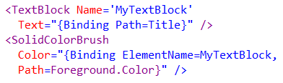

Source Paths
Binding Path Property
Binding.XPath Property
Notes:
The source path is the property on the Source that is being checked for any changes that will subsequently be reflected in the UI elements it is bound to.
The first code example shows the binding of the windows Title property to the text of a TextBlock. The Windows’s Title is the property being checked so this is provided as the Source Path for the binding.
We know it is the Windows Title property that is being used as no ElementName has been specified so the next element up within the visual tree.
The next code sample shows a SolidColorBrush element with a binding to the foreground color of the previous TextBlock. The ElementName declares the object for the binding and the Path specifies the property on the object to view for changes.
The second code snippet shows the XML version of a Source Path (referred to as an Xpath) with the Xpath query for the data to be used.

Slide 16
Binding to non-Dependency Properties
Any public property on a CLR object can be the source property for a binding
Dynamic updates will occur if:
The object implements the INotifyPropertyChanged interface
The object raises a PropertyChanged event when the source property changes
Notes:
Any public property on any CLR object can become the data source for a binding however the changes reflected in the UI will not be automatic as they appear when using dependency properties
The UI will only update dynamically if the object implements the INotifyPropertyChanged interface or if the object fires a PropertyChanged event when the source property changes

Slide 17
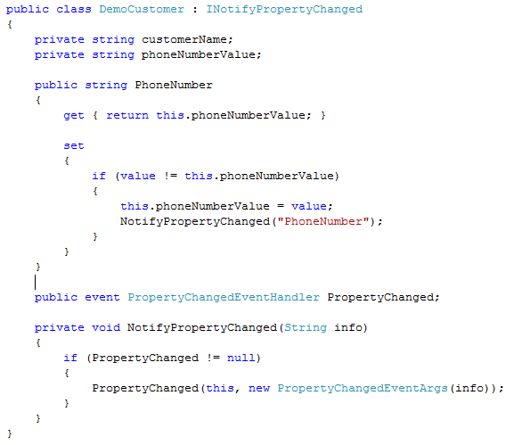
INotifyPropertyChanged
Exposes the PropertyChanged event
PropertyChanged is of type PropertyChangedEventHandler
Notes:
The INotifyPropertyChanged Interface is used to broadcast a change notification on any object that implements it. This is used primarily with data binding as it is used as a signal that a change has occurred in the binding source and now the binding targets can make the relevant changes.
The code sample shows a DemoCustomer class that is designed to hold a customers name and phone number. When the phone number is changed (via the set method) the NotifyPropertyChanged method is fired which triggers the PropertyChanged event.

Slide 18
Binding Modes
The Mode property determines the direction that data flows between the binding source and the binding target:
Binding Target
Binding Source
OneTime
Dependency Object
Object
OneWay
Dependency Property
Property
OneWayToSource
TwoWay
Notes:
[Intro]
The connection that exists between the binding source and the target dependency object is not always an open two way communication channel.
[Click]
OneTime – the data is pushed from the source to he target only once during the applications lifetime.
[Click]
OneWay – the data will only travel from the source to the target. This is used for read-only data and data that will not be updated during the applications lifetime.
[Click]
OneWayToSource - only updates source, never the target. This reverses the binding. One note about this is that the target must always be a dependency property so it can make source a Dependency property
[Click]
TwoWay - updates are reflected on the target and or the source. The target must be a dependency property with binding expression

Slide 19
UpdateSourceTrigger
The UpdateSourceTrigger property determines when the source is updated:
PropertyChanged
LostFocus
Explicit
Notes:
In general, controls are most often updated when a change occurs such as a change in focus or a screen refresh.
For example, a TextBox control will only send updates once it has been tabbed out of or looses focus.
To change this behaviour, you can specify that the binding should update whenever the property changes value using UpdateSourceTrigger markup extension.
This can be set to PropertyChanged, LostFocus and Explicit.

Slide 20
Visualizing Data

Slide 21
Visualizing Data
Content Model
Data Templates
Data Triggers

Slide 22
Content Model
WPF is content centric that provides controls for housing content
ContentControl: Contains a single item
ItemsControl: Contains a collection of items
Both controls can use a DataTemplate for rendering their content
Notes:
There are actually four core content controls in WPF which virtually all controls inherit:
ContentControl. Contains a single content item, for example Label, Window and UserControl inherit directly from ContentControl, as well as ButtonBase.
HeaderedContentControl. This control actually inherits from ContentControl, but also provides a header as well as content item. Examples of HeaderedContentControl include GroupBox, Expander and TabItem.
ItemsControl. Contains a collection of items, for example StatusBar, TreeView and MenuBase.
HeaderedItemsControl. This control actually inherits from ItemsControl, but also provides a header as well as a collection of items. Examples of HeaderedItemsControl include MenuItem, ToolBar and TreeViewItem.

Slide 23
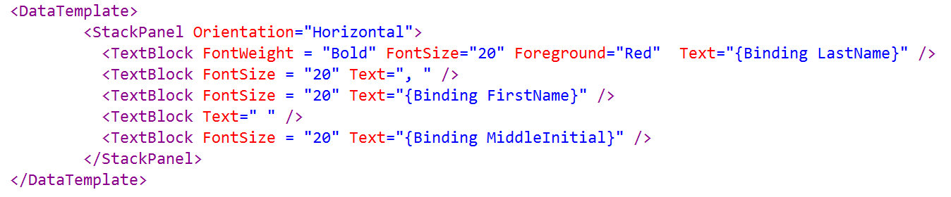
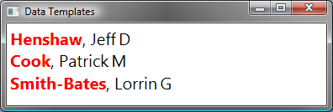
Data Templates
Templates that are applied to data within an Application
Can be applied automatically based on type
Can be applied explicitly by key name
Custom logic can be used to determine the template by using a DataTemplateSelector
Notes:
Data Templates take a piece of data (described as a DataType property) and builds a display tree. Within the tree, you can bind to parts of the piece of data.

Slide 24
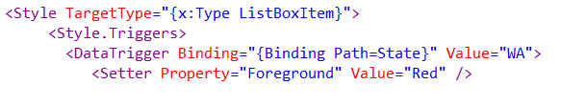
Data Triggers
Data Triggers are used to provide a declarative way of specifying a set of actions that should be performed.
Triggers can use a binding to retrieve the value they should trigger on
Notes:
Data Triggers can be thought of as a simple value converter in markup
DataTrigger uses a binding to retrieve a data value from an object and uses a series of setter and EventSetter objects to create a change in state when the value matches a specified value.
In the code snippet above, a trigger has been set on a Style definition (that will be referenced by a ListBoxItem) that will change the Foreground property to Red when the user data entry for State is equal to WA.

Slide 25
Collections

Slide 26
Collections
Binding to Collections
Collection Views
Sorting, Filtering, and Grouping

Slide 27
Binding to Collections
Collections should implement INotifyCollectionChanged in order to support two way data binding
Many WPF collections implement INotifyCollectionChanged
ObservableCollection<T>
ReadOnlyObservableCollection<T>
Notes:
In many cases the data that applications work with is a collection of objects. A common scenario in data binding is to use an ItemsControl such as a ListBox, ListView, or TreeView to display a collection of records, the INotifyCollectionChange interface enables the UI to stay synchronized with the collection of items. For convenience WPF provides two collection classes that already implement the INotifyCollectionChanged interface:
ObservableCollection. Represents a dynamic data collection that provides notifications when items get added, removed, or when the whole list is refreshed.
ReadOnlyObservableCollection. Represents a read-only version of ObservableCollection, this class is simply a wrapper around ObservableCollection.

Slide 28
Binding to Collections
ReadOnlyObservableCollection<T>
INotifyCollectionChanged
ObservableCollection<T>
CustomCollection
public event NotifyCollectionChangedEventHandler
CollectionChanged;
Items
Item 1
Event Fired
Item 2
Notes:
[Intro]
You can bind to many collections, you can even create your own collection to which you can bind.
[Click]
This collection must implement the INotifyCollectionChanged interface which provides the CollectionChanged event
[Click]
When an item is added/deleted to your collection or an Item changes within the collections Items list
[Click]
The event is fired which notifies bound objects of the changes.

Slide 29
Collection Views
Collection views represent a view of a data collection
Views allow for the following functionality
Grouping
Sorting
Filtering
Current record pointer
CollectionViewSource is the view that can be used easily from XAML
Notes:
The three key elements with data binding are the data source, the binding and the target element. The CollectionView is the fourth key data binding element and is used with list binding.
The CollectionView is responsible for keeping track of the current item as well as filtering, sorting and grouping.
Keeping track of the current item is referred to as “currency management” and this is done using the IsSynchronizedWithCurrentItemProperty on a control such as a list.
You can bind a collection to a collection-valued property (such as ItemSource)

Slide 30
Sorting, Filtering, and Grouping
SortDescriptions
CollectionViewSource.Filter event
CollectionView.Filter property
GroupDescriptions
Notes:
Sorting is done by adding one or more SortDescription objects using the CollectionView.SortDescriptions.Add () method
Filtering involves you providing a delegate call back that determines whether an item should be visible to the controls – this can be done using either the default view or a new view.
The CollectionView.Filter property is passed the delegate call back to determine if an item is suitable for inclusion in the view.
The filtered data can then be bound to a control in the normal way
Grouping requires the support from the collection view and the control that is binding to the data.
The collection view is handled in the same way as sorting – GroupDescription objects added using the CollectionView.GroupDescriptions.Add () method
On the control side, the WPF controls support a GroupStyle property for this.

Slide 31

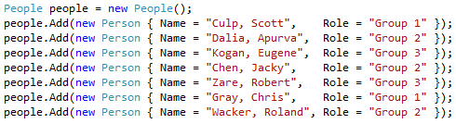
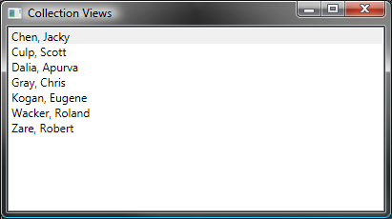
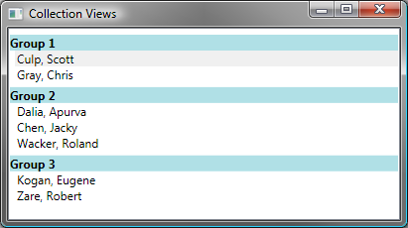
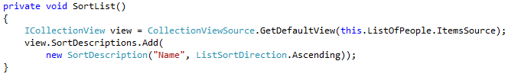
Sorting and Grouping
Grouping
Data
Sorting

Slide 32
Conversions

Slide 33
Conversions
Value Converters
Demo: BoolToVisibilityConverter
Value Converters In XAML

Slide 34
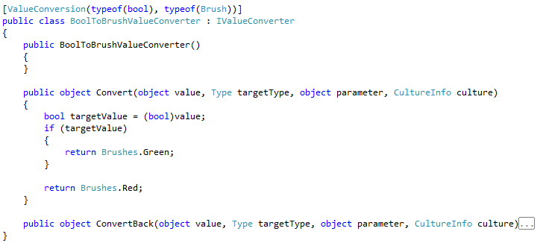
Value Converters
To convert values during data binding implement IValueConverter:
Notes:
Value Conversion may be needed when the source and destination have mismatched data types. The two methods that can be used for this are TypeConverter and the new IValueConverter interface.
The interface contains two methods that need to be implemented – Convert and ConvertBack
Note in the example on the slide a Boolean value is being converted to a SolidColorBrush, where Red represents and False and Green represent True.

Slide 35
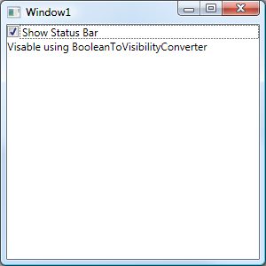
BoolToVisibilityConverter
demo
Notes:
This application demonstrates how to implement a custom BoolToVisibilityConverter Value Converter that will be used to enable a TextBlock based on the value of a CheckBox
You can use the completed solution file from <install path>\Module 06\Demos\BooleanToVisibilityConverter\BooleanToVisibilityConverter.sln to help with the demonstration
1. Create a new WPF Application in Visual Studio 2008 and name the solution BooleanToVisabilityConverter
2. In Solution Explorer, right click the project, select Add, and then click Class
3. Enter Converter as the class name and click OK
4. Ensure that you use the following Using statements in the class
using System;
using System.Windows;
using System.Windows.Controls;
using System.Windows.Data;
5. Ensure the class implements the IValueConverter interface by typing : IValueConverter after the class name
6. Right click the IValueConverter interface, point to Implement interface and then click Implement Interface Explicitly. This will create skeleton code for the Convert and ConvertBack methods.
7. Delete the exception code in the Convert method and replace it with the following code snippet
bool flag = false;
If (value is bool)
{
flag = (bool)value;
}
else if (value is bool?)
{
bool? nullable = (bool?)value;
flag = nullable.HasValue ? nullable.Value : false;
}
return (flag ? Visibility.Visible : Visibility.Collapsed);
8. Delete the exception code in the ConvertBack method and replace it with the following code snippet
return ((value is Visibility) && (((Visibility)value) == Visibility.Visible));
10. Open the Window1.xaml and enter the following namespace definition
xmlns:local="clr-namespace:BooleanToVisibilityConverter"
11. To create a reference for the converter class, type the following code in the Window element
<Window.Resources>
<local:Converter x:Key='myConverter'/>
</Window.Resources>
12. Type the following code in the Grid element of the main window
<StackPanel>
<CheckBox x:Name="checkBox">Show Status Bar</CheckBox>
<TextBlock Visibility="{Binding ElementName=checkBox, Path=IsChecked, Converter={StaticResource myConverter}}">Visable using BooleanToVisibilityConverter
</TextBlock>
</StackPanel>
13. Compile and run the application, note that when you select the checkbox control, the TextBlock becomes visible.

Slide 36

Value Converters In XAML
To use your new value converter class it must first be referenced as a resource with a key
The Converter tag can then be used (using a StaticResource markup extension) to reference the converter on the target object
Converter Tag
Key
Notes:
When a converter class has been created in the code behind file (implementing IVAlueConverter) it is nessasary (as with other CLR object) to reference the XML namespace in the XAML
An instance of the class can then be referenced in the Resources part of a WPF Window
We can then specify the converter we wish to use on the target object. The following code uses “myConverter” to convert the Binding Path (count) into object (in this case, a Brush)

Slide 37
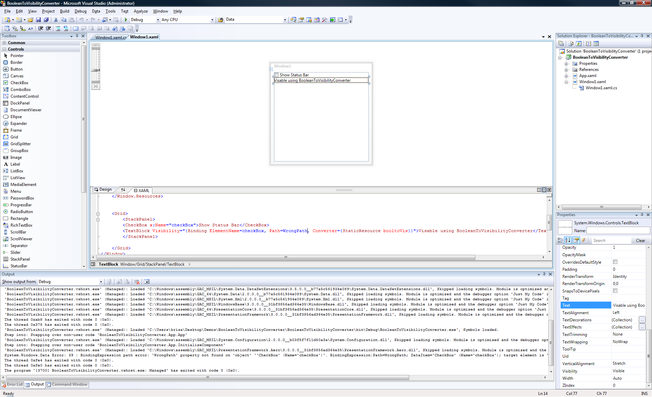
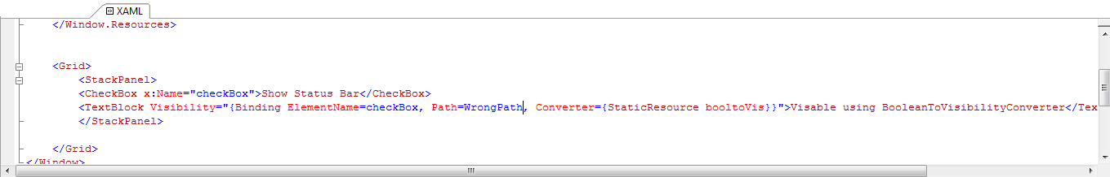
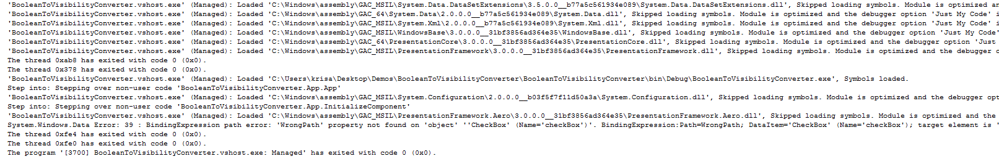
Troubleshooting Data Binding
System.Windows.Data.Error: 39 : BindingExpression path error: 'WrongPath' property not found on 'object' ''CheckBox' (Name='checkBox')‘ …

Slide 38
Contact
Twitter: @kdawg02
Blogs
http://karlshifflett.wordpress.com/
http://blogs.msdn.com/b/kashiffl/
http://blogs.msdn.com/b/wpfsldesigner/
Links
http://compositewpf.codeplex.com/
http://msdn.microsoft.com/en-us/practices/default.aspx

Slide 39

© 2007 Microsoft Corporation. All rights reserved. Microsoft, Windows, Windows Vista and other product names are or may be registered trademarks and/or trademarks in the U.S. and/or other countries.
The information herein is for informational purposes only and represents the current view of Microsoft Corporation as of the date of this presentation. Because Microsoft must respond to changing market conditions, it should not be interpreted to be a commitment on the part of Microsoft, and Microsoft cannot guarantee the accuracy of any information provided after the date of this presentation. MICROSOFT MAKES NO WARRANTIES, EXPRESS, IMPLIED OR STATUTORY, AS TO THE INFORMATION IN THIS PRESENTATION.

